Slide 1



Conditional Statements
01
02
Logical expressions and checks. Conditional statement if-else.
03

Slide 2
Content
04
01
Comparison operators
05
02
Conditional statements
06
03
Debugging

Slide 3
Content
01
02
03
04
Nested conditional statements
05
Logical operators

Slide 4
01
Comparison operators
Logical expressions and checks

Slide 5
Comparison operators
Operator | Sign
Equal to | ==
Not equal | !=
Greater than | >
Greater than or equal | >=
Less than | <
Less than or equal | <=

Slide 6
Compare values
In programming, we can compare values The result of logical expressions is true or false
int a = 10;
int b = 5;
sc.print( a > b );
sc.print( a > 0 );
sc.print( a > 100 );
sc.print( a < a );
sc.print( a <= 10 );
sc.print( b == 50 / a );
// true
// true
// false
// false
// true
// true

Slide 7



03
Conditional statements
Simple checks

Slide 8
Simple checks
We often check conditions and perform actions according to the result
The result of the check is true or false
Condition True Execution Code
Condition (Boolean expression)
if (...) {
// Execution code
}

Slide 9
Mark
Write a function that:
Read a mark (number)
Checks to see if it's excellent.
Prints "Excellent!" on the console if the mark is greater than or equal to 5.50
Example:
4
no output
5.50
Excellent!

Slide 10
Block diagram
Read input
No output
grade >= 5.50
false
true
Print output

Slide 11
if-else
In case of falseness of the condition, we can perform other actions – through the else construction
if (...) {
// Execution code
} else {
// Execution code
}
Condition Incorrect
Execution Code

Slide 12
The Higher Number – Condition
Write a program that:
Receives two integers
Displays "Greater number: "
Prints the larger of them on the console
Example:
6
8
5
3
8
5

Slide 13
Block diagram
Read input
Print output
num1 > num2
false
true
Print output

Slide 14
Series of checks
The if/else-if/else... is a series of checks
If a condition is true, do not proceed to check the following conditions
if (...)
// Execution code
else if (...)
// Execution code
else if (...)
// Execution code

Slide 15
Series of checks - example
The program checks the first condition, establishes, that it's true and the execution ends.
int a = 9;
if (a > 4)
sc.print("Bigger than 4");
else if (a > 5)
sc.print("Bigger than 5");
else
sc.print("Equal to 9");
Displays only "Bigger than 4" on the console

Slide 16
Numbers 0 to 9 with text
Write a function that:
Receives an integer
Checks its value [0.9]
If the number is greater than 9 prints "too big"
Prints the value with text
Example:
7
seven
10
too big

Slide 17
Numbers 0 to 9 with text
if (num == 0)
sc.println("zero");
else if (num == 2)
sc.println("two");
else if (num > 9)
sc.println("too big");

Slide 18
Variable Scope
Range within which it can be used Example: The variable price exists only in the if-construct code block
String day = "Monday";
if (day == "Monday") {
int price = 5;
}
sc.print(price); // Error

Slide 19
Face on figure
Write a function that: Receives the appearance of a geometric figure ("square", "rectangle", "circle" or "triangle") Calculates the face according to the type of figure Sample input and output:
square, 5
25
rectangle, 10, 3.5
35

Slide 20
Conditional Statement switch-case
Works as a series if/else if/else if…
switch (...) {
case ...:
// code
break;
case ...:
// code
break;
default:
// code
break;
}
The condition in switch case is variable
List conditions (values) for the check
Code that will run if there is no match with any case

Slide 21
Conditional Statement switch-case
Through switch-case, we can execute the same code for multiple conditions
switch (...) {
case ...:
case ...:
case ...:
// code
break;
default:
// code
break;
}
The code will be executed if any of the three conditions in the series are true

Slide 22

04
Debugging
Simple debugger operations

Slide 23
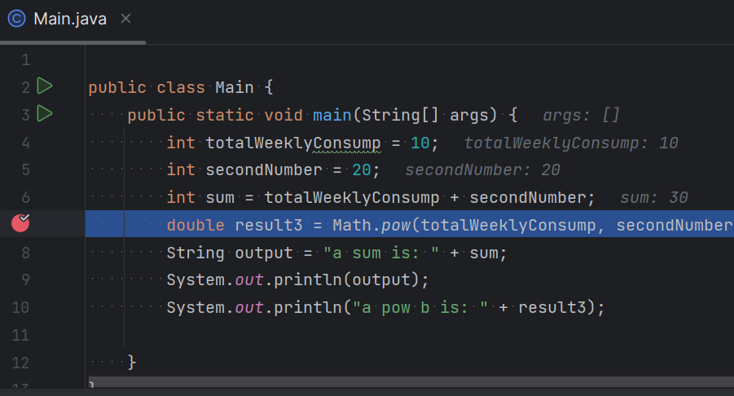
Debugging
Process of monitoring the implementation of the program
This allows us to detect errors in the code (bugs)
Breakpoint

Slide 24
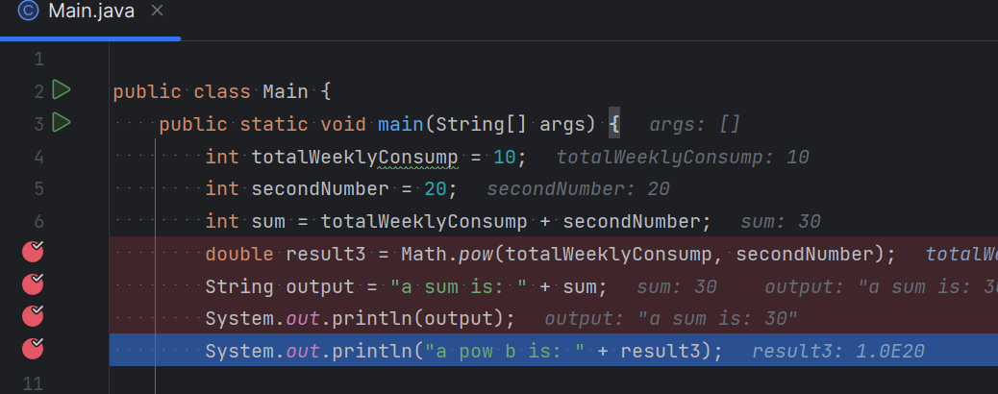
Debugging
Pressing [shift + F9] will start the program in debug mode
We can move on to the next step with [F8]
We can create [ctrl + F8] stoppers – breakpoints We can get to them directly using [F9]

Slide 25
05
Nested conditional statements

Slide 26
Nested checks
Only when the first condition is met the nested check is reached
if (condition1){
sc.println("condition1 valid");
if (condition2)
sc.println("condition2 valid");
else
sc.println("condition2 not valid");
}
Nested if construction

Slide 27
Address by age and gender
Write a function that receives: Age Gender Prints an address according to the data entered, as shown in the diagram (in the next slide) Sample input and output:
12
f
16
m
Miss
Mr.

Slide 28
Block diagram
Read input
true
false
gender equals 'f'
age < 16
age < 16
true
false
true
false
Print "Miss"
Print "Ms."
Print "Master"
Print "Mr."

Slide 29
Grocery store - Task
Write a function that: Receives as parameters: Product name, city and quantity Calculate its price according to the table:
City/product | coffee | water | juice | sweets | chips
Sofia | 0.50 | 0.80 | 1.20 | 1.45 | 1.60
Plovdiv | 0.40 | 0.70 | 1.15 | 1.30 | 1.50
Varna | 0.45 | 0.70 | 1.10 | 1.35 | 1.55

Slide 30
Grocery store
Sample input and output:
coffee
Varna
2
chips
Plovdiv
1
juice
Sofia
6
0.9
1.5
7.2

Slide 31
Block diagram
Read input
price = 0
true
false
town == "Sofia"
true
false
Check the other cities
and products
product == "juice"
price = 1.20
Check the other products
and set price

Slide 32
Grocery - solution
string product = sc.nextLine();
string town = sc.nextLine();
int quantity = Integer.parseInt(sc.nextLine());
double price = 0;
if (town == "Sofia")
{
if (product == "coffee")
price = quantity * 0.50;
// TODO: check all the products
}
else if (town == "Plovdiv")
else if (town == "Varna")

Slide 33
05
Logical operators
&&, ||, !

Slide 34
Boolean operators
Operators combining or excluding conditions Return Boolean result (true or false)
"&&" - and
"||" - or
"!" - NEGATION
true
true
false
true
false
Trueness of both conditions
Trueness of one the conditions
Condition Negation

Slide 35
Logical "And"
Checks the fulfillment of several conditions at the same time Example: check if a number is simultaneous: greater than 5 and less than 10
&&
int a = 5;
if ((a > 5 && a < 10) && a != 2 == 0) …

Slide 36
Logical "OR"
Checks to see if at least one of several conditions is met Example: check if the entered word is "Test" or "Demo"
||
if (word == "Test" || word == "Demo")

Slide 37
Logical negation
Checks to see if a condition is not met Example: Check if a number is greater than 10 and even:
!
int number = 5;
bool isValid = (number < 10) && (number > 0);
if (!isValid)
{
Console.WriteLine("Invalid");
}

Slide 38
Priority of conditions
By parentheses () we can prioritize conditions
int a = 50;
int b = 200;
int c = 300;
if ((a >= 100 && b <= 200) || (c + b >= 300 && c <= 400)) {
sc.print("First"); // First
}
if (a >= 100 && (b <= 200 || c + b >= 300) && c <= 400) {
sc.print("Second"); // No output
}

Slide 39
Summary
Condition Verification Structures IF and IF-ELSE Variable life Debugging Switch-case statement
Nested conditional statements: More complex checks with &&, ||, ! and ()

